Slide 1
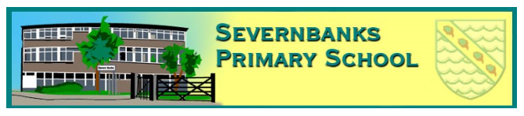
Welcome to
Year One
Rowan Class
Class Dojo
We use Class Dojo to reward the children for good learning behaviours in class and around the school. I also use it to
tell you about what we are doing in class, show you photos and to share important messages so that you can see what
we get up to at school during the week. You can also message me privately using Dojo if you have a question or a concern. Please use the details about how you can join Class Dojo that are attached to this letter. Thank you
Staff
Monday – Miss. Webster
Tuesday – Friday
Mrs. Jones
Teaching Assistants
Mrs. Baker
Mrs. Anderson
Routine
The children in Year 1 have three outside playtimes with the children in Year 2 per day. One mid morning, lunchtime and one mid afternoon.
PE
This will take place on a Monday, please make sure that your child has a full PE in school. Thank you.
We will continue to do
the Daily Mile in the mornings and Yoga on Tuesdays with Caroline.
Reading
We try to read with the children as often as possible so please ensure that your child's reading books are in school every day. Books will be changed on a Friday.

