Slide 1
International Day of Democracy is 15/9/24

Slide 2
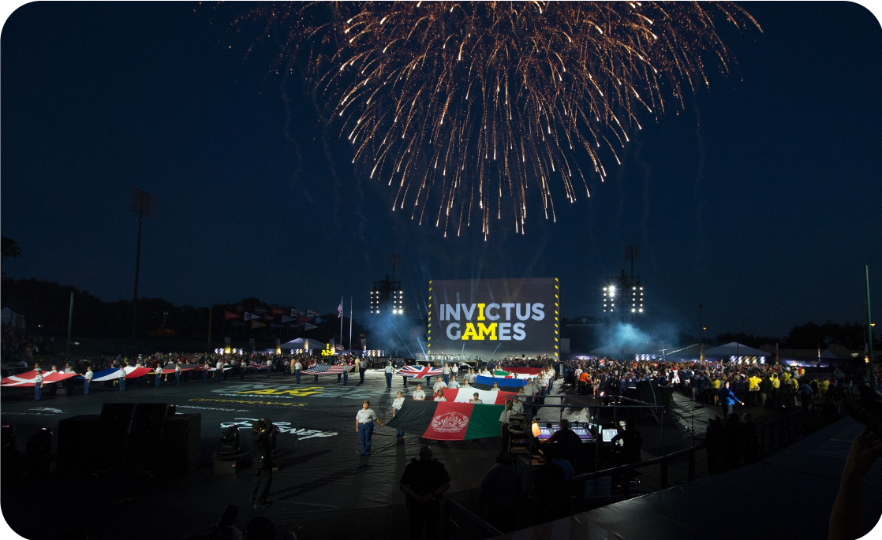
What Do You Know
about Democracy?

Slide 3
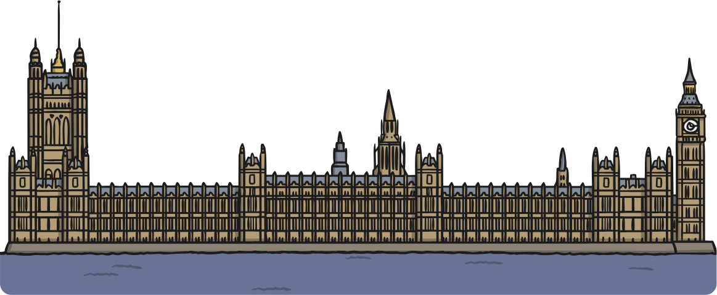
What Is a Democracy?
We have a political system that is called a democracy.
Democracy means ‘rule by the people’. It comes from the Greek words dêmos, which means people, and krátos which
means rule or strength.
This means that our country is ruled by the people.

Slide 4


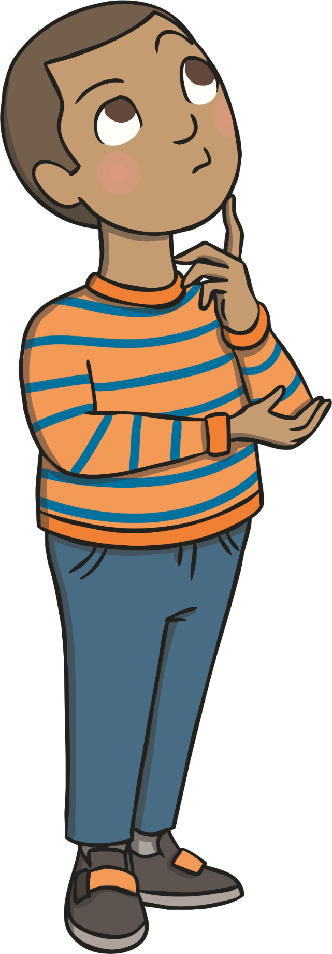
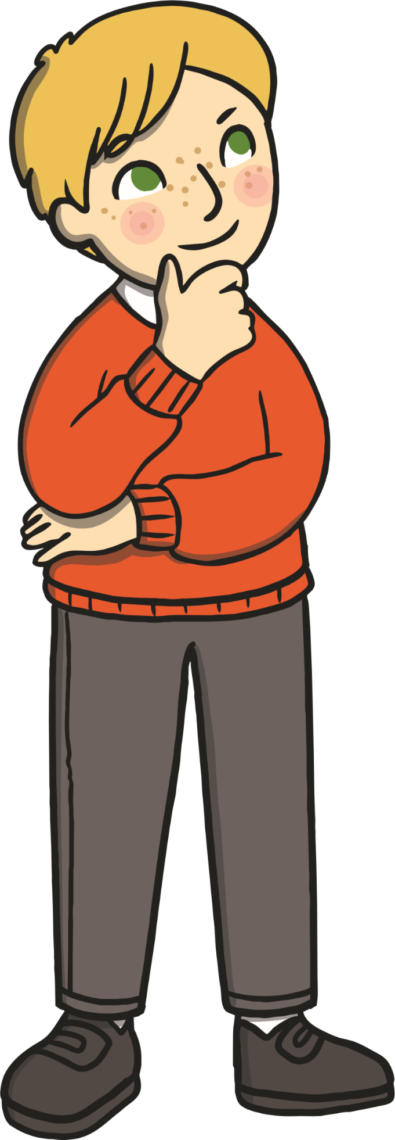
Ruled by the People?
What do you think this means?
Do we get to decide on the rules?

Slide 5
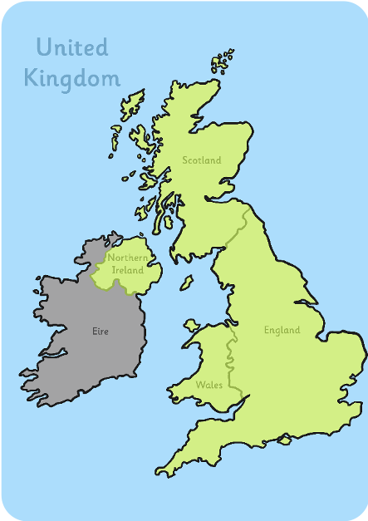

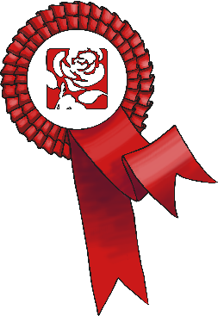

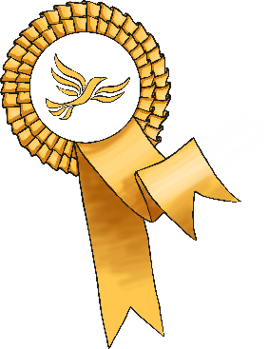


What Does Democracy Mean?
In the United Kingdom, we hold an election to choose someone to represent us.
Most candidates who ’stand’ for election belong to a political party – a group of people who share similar beliefs.
Together, people who belong to the party agree on changes they will make if they are elected. These are called policies.
The leaders of the political parties share their main policies with members of
the public.

Slide 6
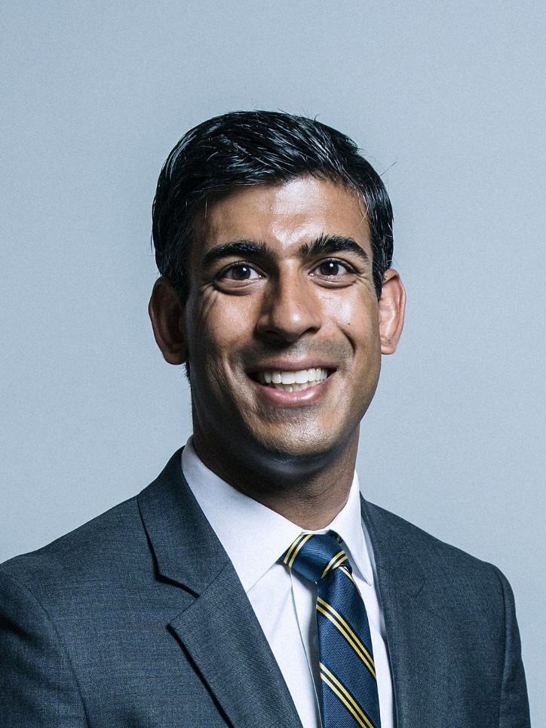
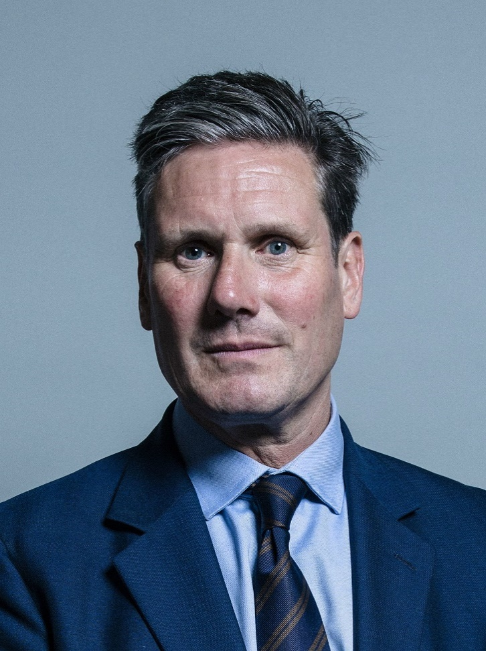
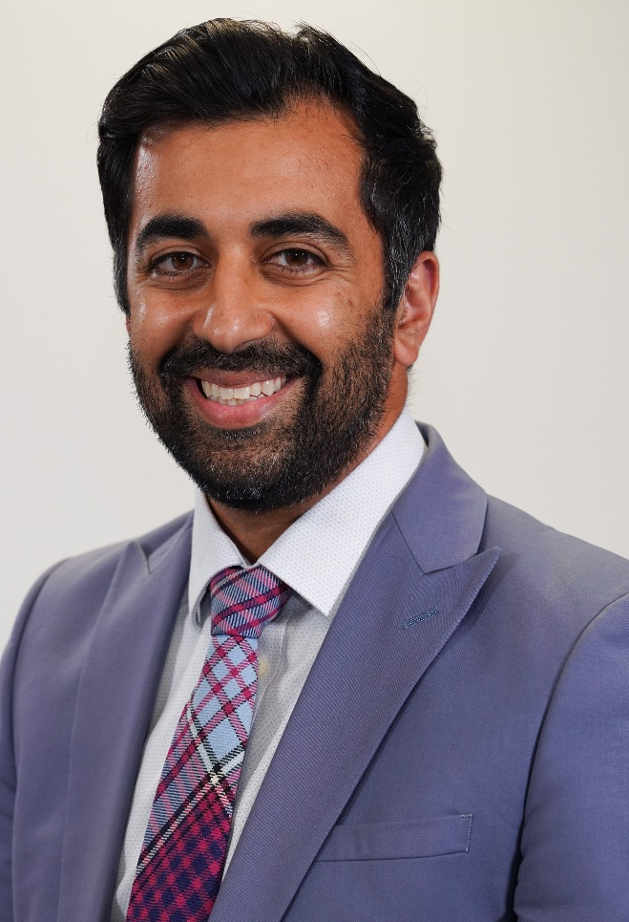
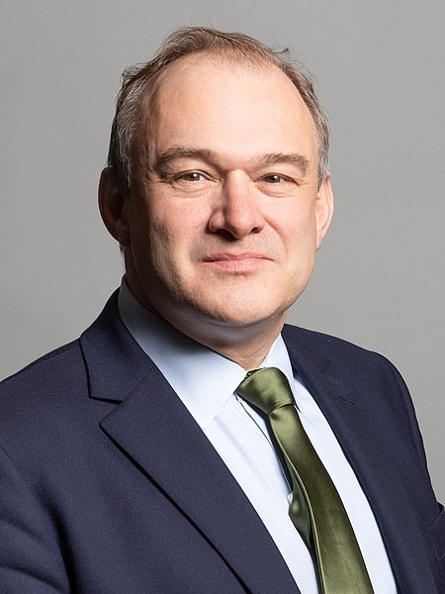

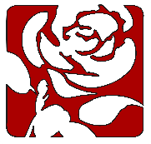


The Main Political Parties
“Official portrait of Rishi Sunak, taken June 2017” by
Chris McAndrew , CC BY 3.0, via Wikimedia Commons
"Cabinet Secretary for Health and Social Care, Humza Yousaf" by Scottish Government is licensed under CC BY 2.0
"Official portrait of Rt Hon Sir Edward Davey MP in 2020" by Richard Townshend is licensed under CC BY 3.0
Rishi Sunak
Conservatives
Sir Keir Starmer
Labour
Humza Yousaf SNP
Ed Davey
Liberal Democrats

Slide 7
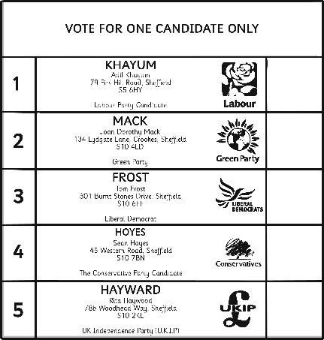
How is a Political Party Elected?
Every citizen should listen to the policies of the different parties and candidates. Then they should decide on who to vote for.
People must be 18 or over to take part in an election.
Each person votes for the candidate of his or her choice. They do this by putting a ‘X’ cross beside the person’s name on the ballot paper.
At the end of the election day, the votes are added up. The candidate with the highest number of votes (the majority) is declared
the winner.

Slide 8
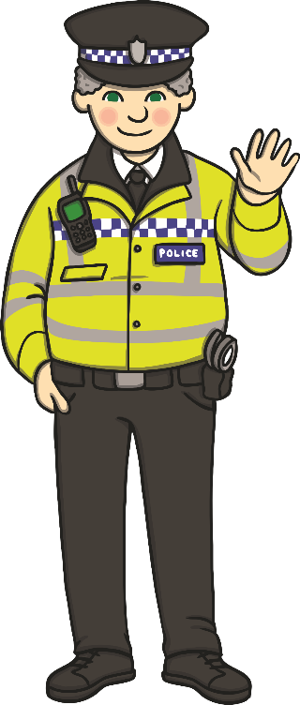
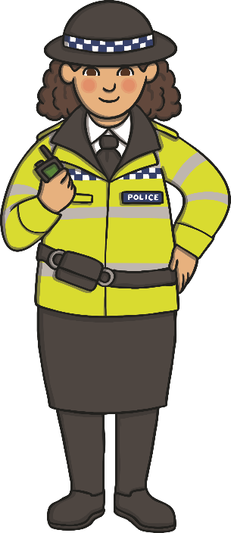
In Our Democracy, Every Citizen Has Certain Basic Rights.
No one can tell you what you must think, believe, say or not say.
Everyone is free to choose their own religion and to worship and practice their religion as they want to.
Every individual has the right to enjoy their own culture, along with other members of their group, even if their group is a minority.
However everyone must exercise these rights peacefully, with respect for the law and the rights of others.

Slide 9
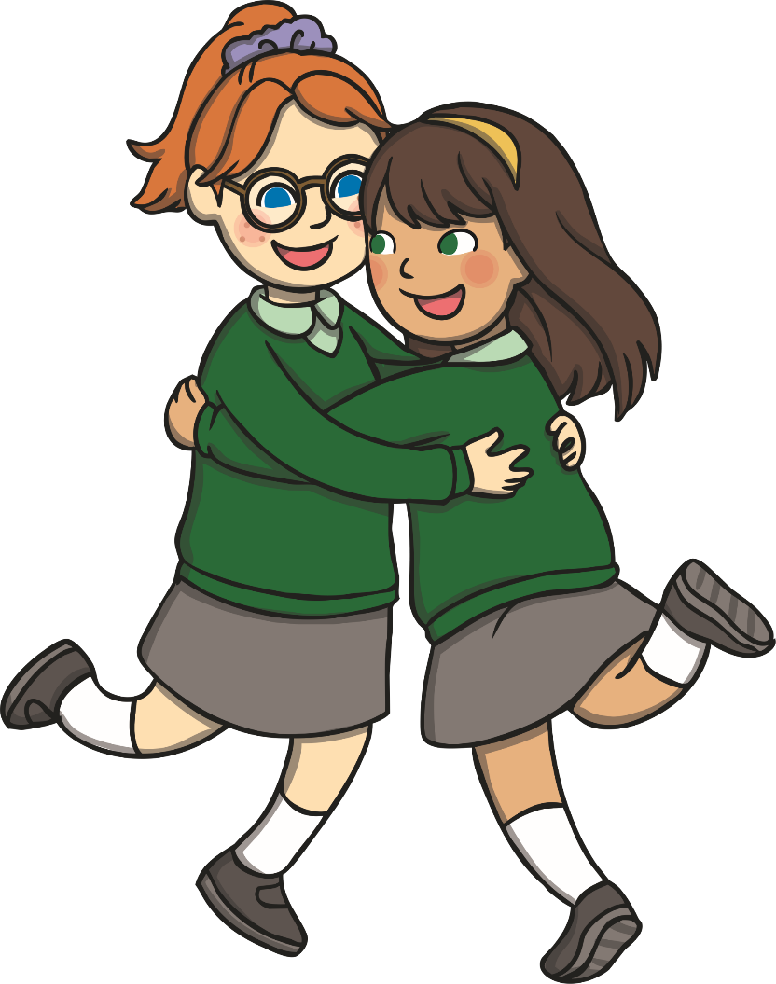
How Might You Have a Democracy in Your School?
All pupils in the school are involved in the school council. It is pupil-led.
The staff and the children believe that it plays an important role. It deals with significant issues.
It makes a difference.

