Slide 1

What are out British Values?

Slide 2


Slide 3
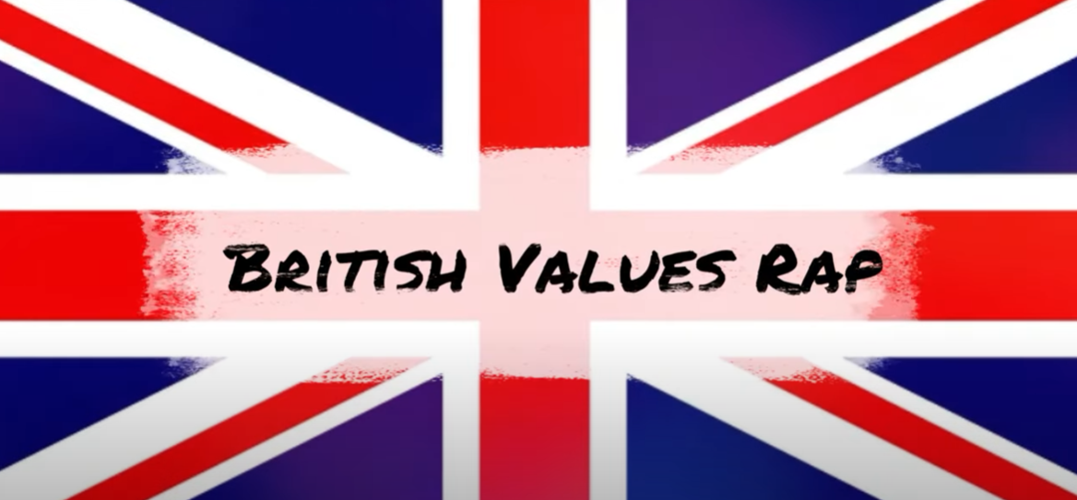
https://www.youtube.com/watch?v=P8lxvCkJZAY - Rap

Slide 4
How is our School Council linked to British Values?

