Slide 2
The Big Questions

Slide 3

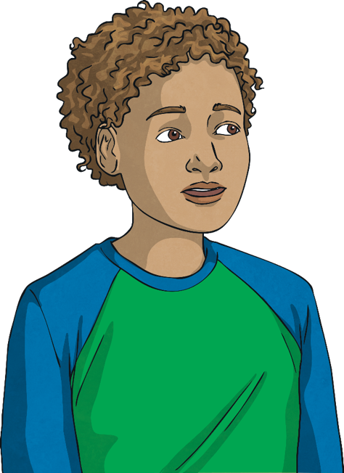
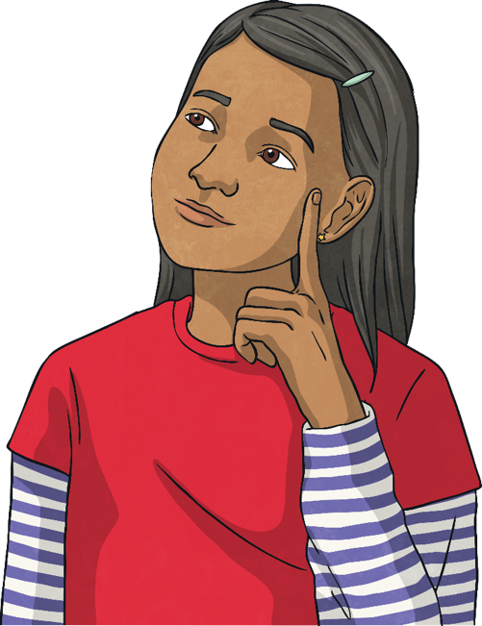
What does it
mean to be a
global citizen?
How can we be responsible
global citizens?

Slide 4
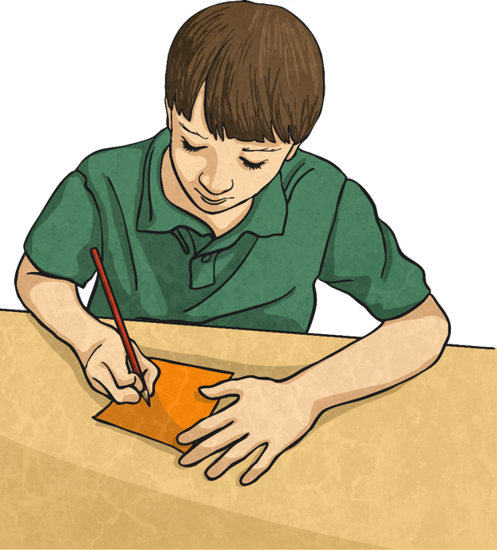
Citizens and Citizenship
What does it mean to be a global citizen?
Take a moment to think about this.

Slide 5

Citizens and Citizenship
We often hear the word ‘citizen’ but what does it really mean?
A citizen is someone who belongs to a particular place. For example, the citizens of a town or city are the people who live there. A citizen is an inhabitant of any place.
We are all citizens. Where are you a citizen of?
So, what about citizenship? What does that mean?
Citizenship is how we live in the areas to which we belong. It is all about behaving in a way that is responsible and considerate to the area and others living in it.
Let’s find out a little bit more!

Slide 6
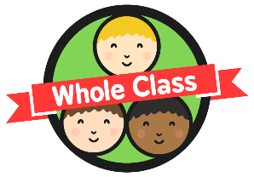
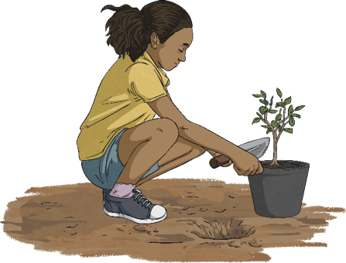
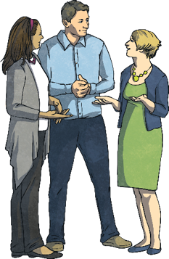
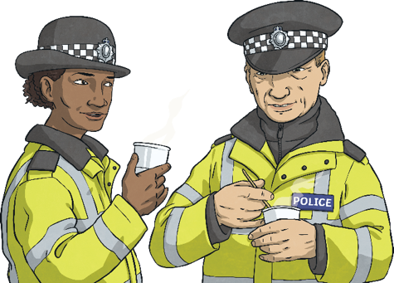
Going Global
We can show good citizenship, or be a good citizen of the places we belong to, in lots of ways.
Look after the environment.
Follow the laws and rules.
Volunteer in your community.
Respect the rights and property of others.

Slide 7
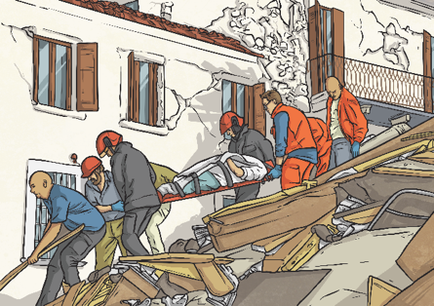
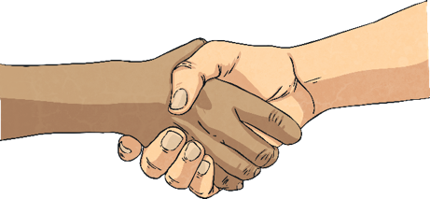
Going Global
Help people in need.
Be honest and trustworthy.
Be compassionate – care genuinely about other people and living things.
By doing these things, we help everyone live happier lives, feel safer and ensure the places in which we live are looked after… how amazing to be a part of something like that!

Slide 8
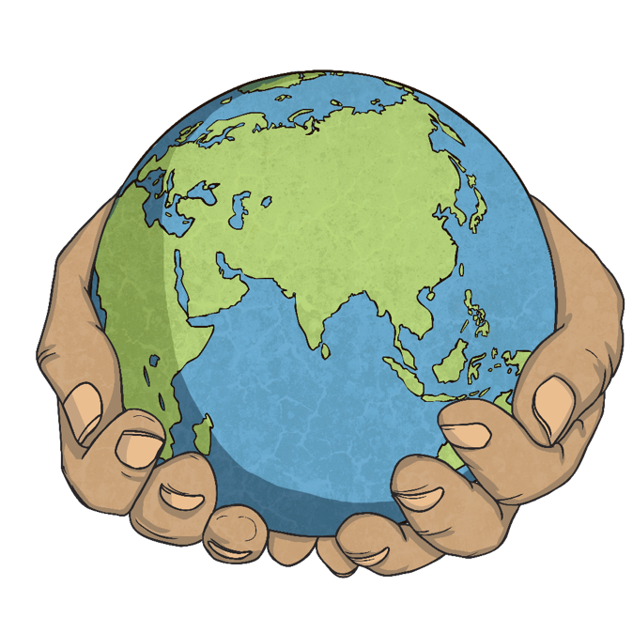
Going Global
We are all citizens of the places in which we live. But let’s think bigger now… what one place is every single human a citizen of?
Yes, you’ve got it… the world! We are all global citizens. We all belong to one world. This is something to be celebrated!
Being a responsible global citizen means engaging with the world in which we live in a responsible way for the good of all across the globe and for the good of
the environment.
But what does this look like in action?

Slide 9
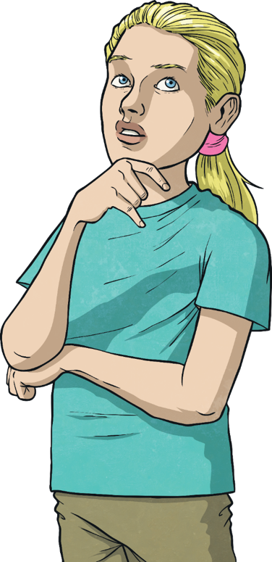
Being Responsible
So, what have we learnt about how to be responsible global citizens?
Be aware of what is happening in the world.
Be active citizens – volunteer, campaign and educate others about important global issues.
Respect and celebrate differences throughout the world.
Show empathy towards others in different countries.
Be curious about the world and want to find
out more.

Slide 10
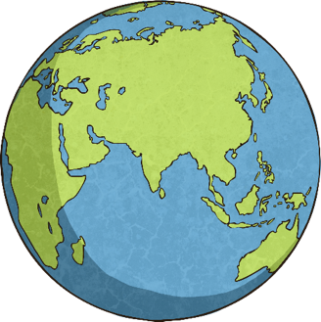
Being Responsible
Believe you can make a difference.
Respect and protect the global environment.
Promote sustainability (meeting the needs of the present without endangering the future).
Have a global mindset – know all people have the same rights, wherever they are in the world and live in a way which respects these rights.

