Slide 1


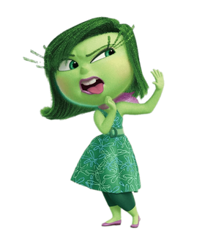

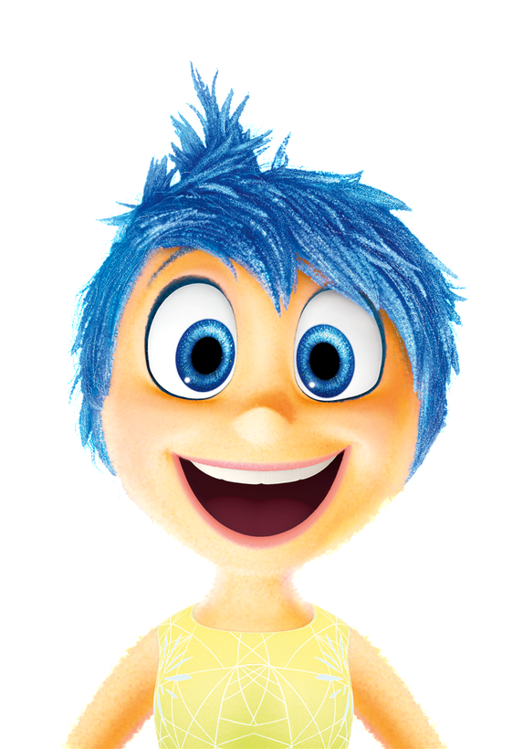


World Mental Health Day 2024
Mental Health Matters for Everyone
10th October 2024

Slide 2

When is World Mental Health Day?
World Mental Health Day is celebrated every year on October 10th. This year, we’re talking about mental health in the workplace and how important it is to look after our feelings.

Slide 3


What is mental health?
Mental health is how we feel inside. Just like we take care of our bodies, we need to take care of our minds too!

Slide 4

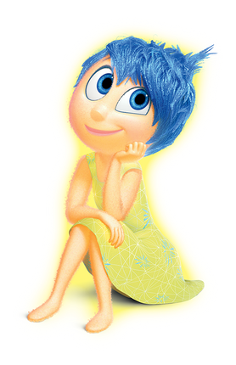
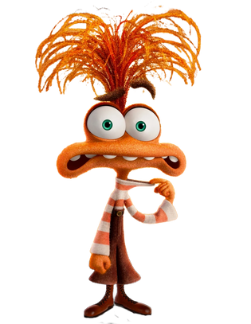
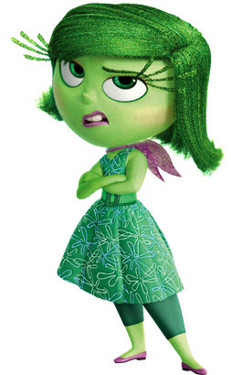
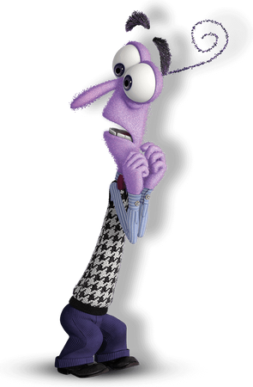
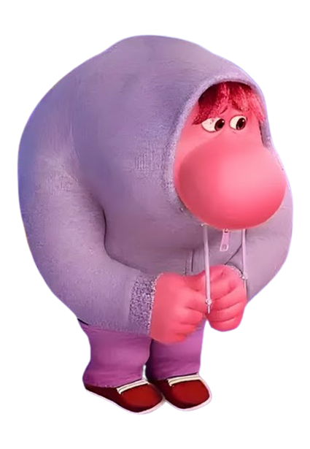
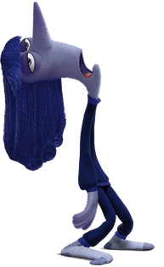
Meet the Inside Out 2 Team!
Can you name them? When might you feel these emotions?

Slide 5
Meet the Inside Out 2 Team!
Can you name them? When might you feel these emotions?
Joy
Sadness
Anger
Disgust
Fear
Envy
Bored
Anxiety
Embarrassment

Slide 6
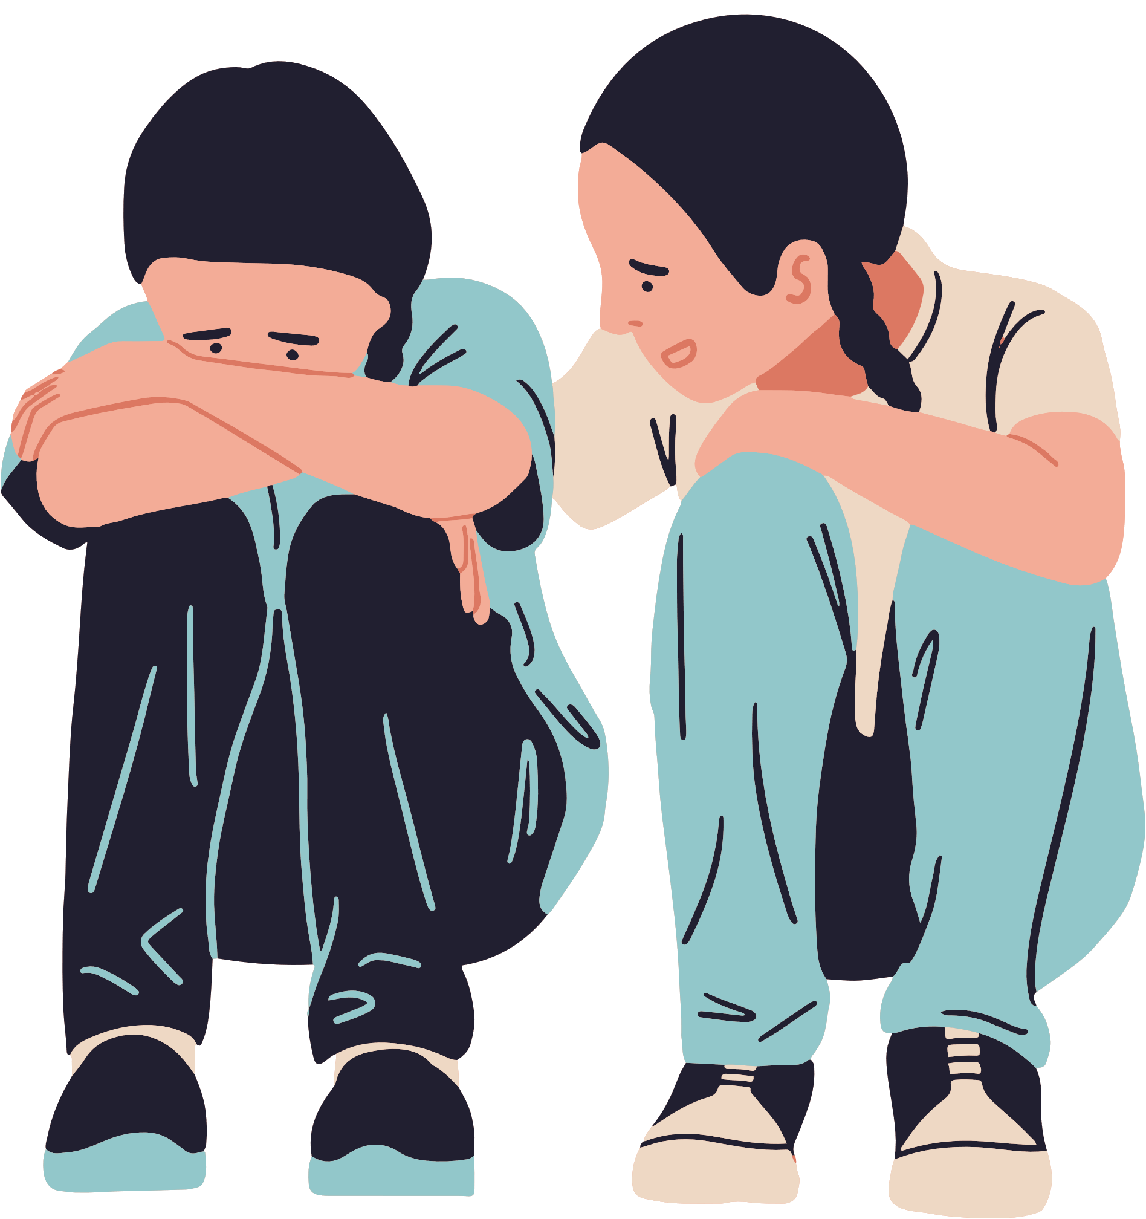
Mental Health at School and Work
Mental health is important for everyone, whether you're a pupil or teacher! Being kind to others and talking about our feelings can help us feel better.

Slide 7


Who helps us at school?

Slide 8

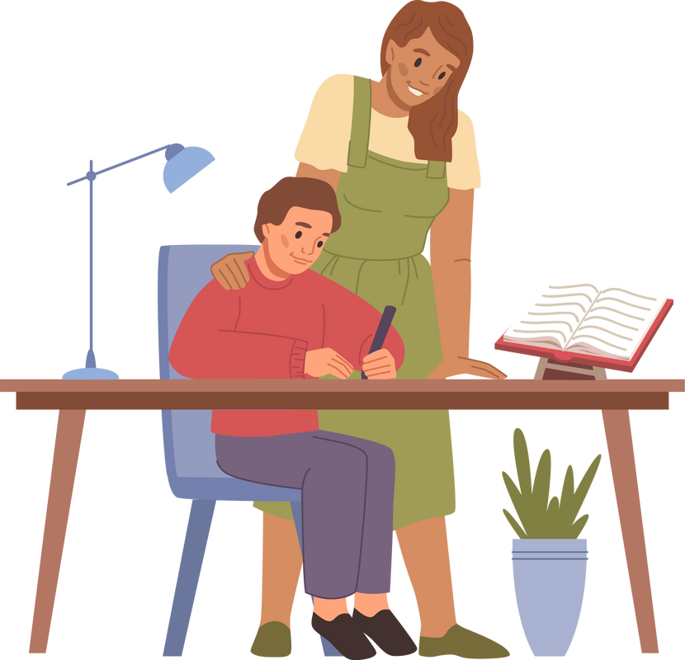

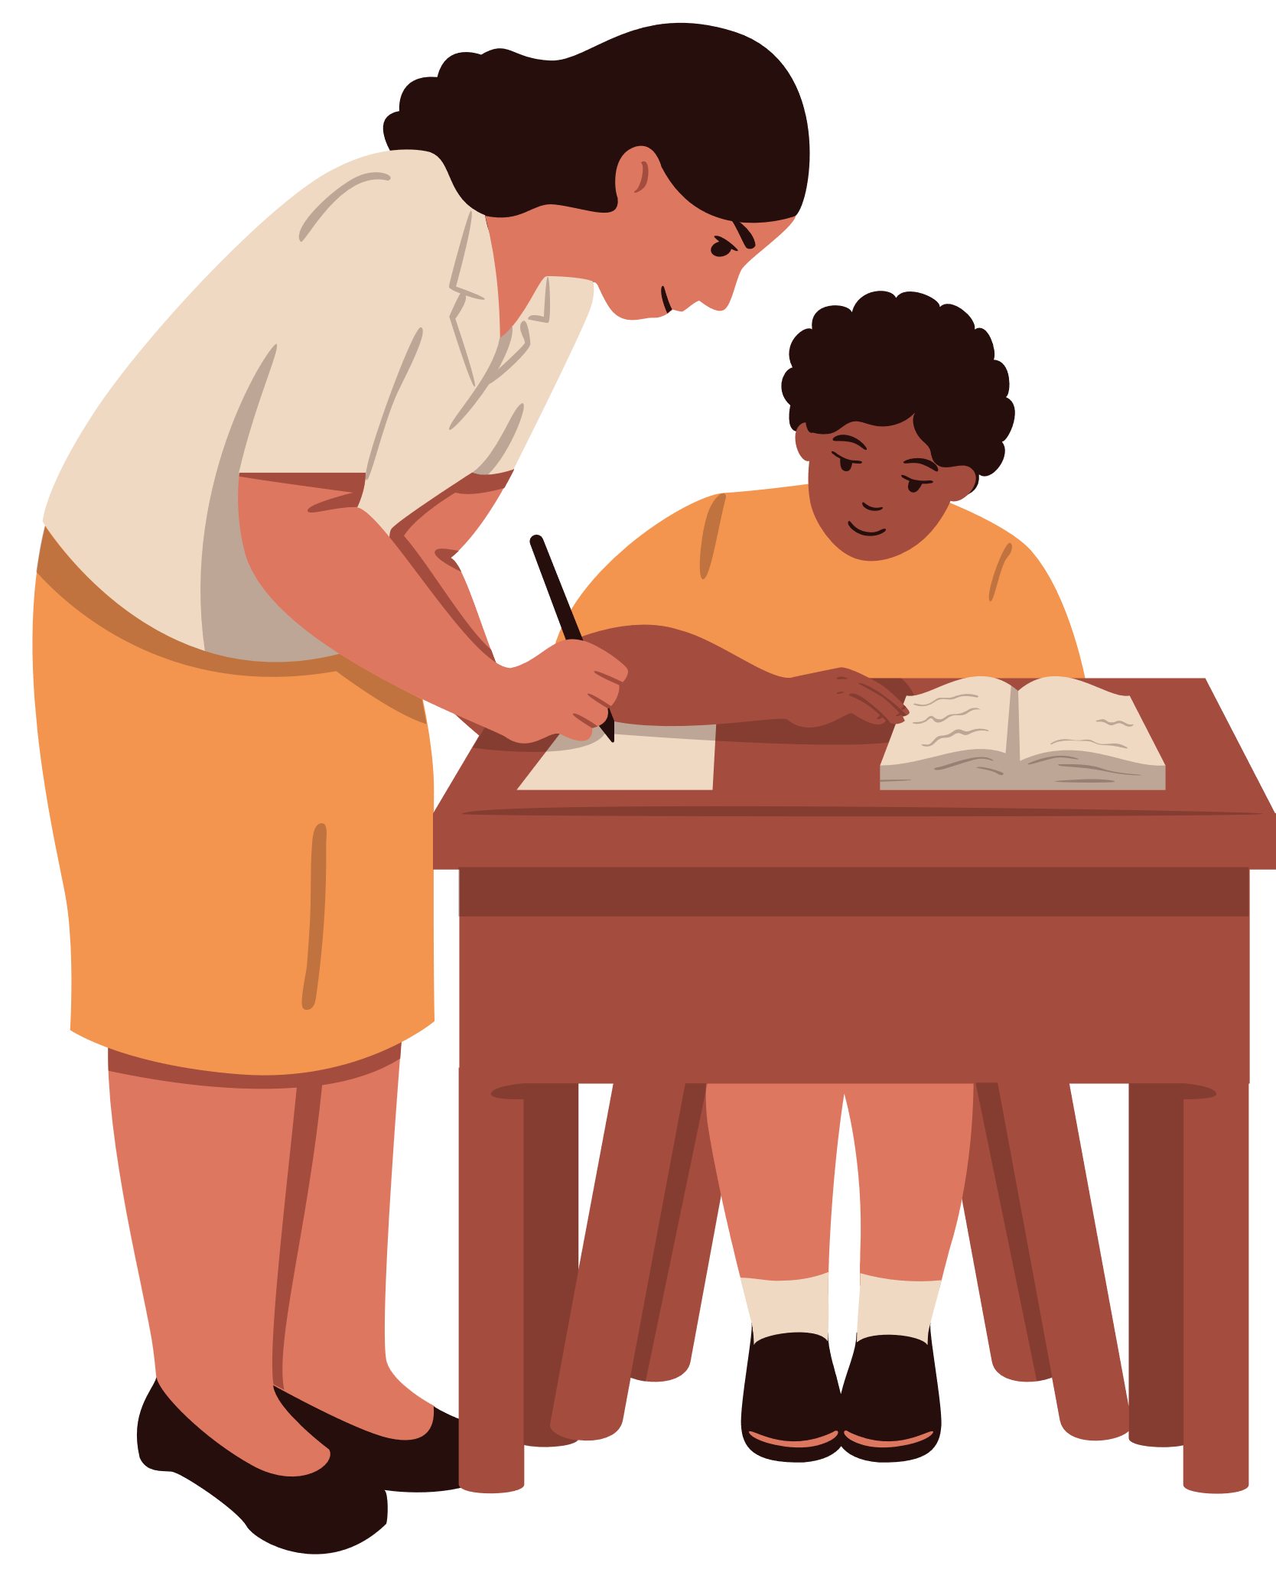

Friends and Classmates
  How they help us: They play with us and make school fun!
  How we can help: Be kind, share, and check on your friends when they seem sad.
Teachers
Teaching assistants
Who helps us at school?
  How they help us: They give us extra support and help us when we’re stuck.
  How we can help: Be polite, ask for help when you need it, and share your progress.
  How they help us: They teach us, listen to our problems, and help us learn.
  How we can help: Be respectful, say thank you, and help keep the classroom tidy.
Lunch Staff
  How they help us: They make sure we have a clean and safe space to eat and play.
  How we can help: Keep areas clean, say please and thank you, and be respectful.

Slide 9
Coping with Big Emotions
Sometimes, our emotions feel too big. Here are ways to help:
  Talk to a friend or teacher.
  Take deep breaths.
  Write or draw your feelings.

Slide 10

How to Check-In with Others
Checking in with our friends and family helps us understand how they feel. Try asking, 'How are you feeling today?'
How are you feeling today?
I’m feeling worried!

Slide 11


Let’s Have a Tea & Talk!
Talking about how we feel is a great way to support each other. Maybe have a 'Tea & Talk' with your family or friends to chat about your feelings!

Slide 12


Remember – You’re Not Alone!
If you’re ever feeling sad, worried, or upset, it’s okay to ask for help. You’re never alone.

Slide 13
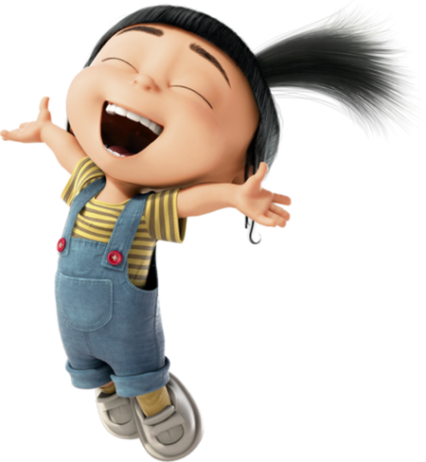

Teaching assistants
Teachers
Friends
  What you can say: “I’m feeling a bit down, can I tell you about it?”
  How they help: They can help you work through your feelings, give you extra support, or find a quiet space for you to relax.
  What you can say: “I’m feeling upset, can I talk to you for a moment?”
  How they help: Teachers are always there to listen and give advice. They can help you find a solution or just offer a friendly ear.
  What you can say: “I’m feeling sad today, can we talk or play together?”
  How they help: Friends can cheer you up, listen to how you’re feeling, or just be with you when you need someone close.
Family
Other Trusted Adults (Lunch Staff, Office Staff, etc.)
  What you can say: “I’m not feeling like myself today. Can I talk to you?”
  How they help: Your family loves you and will always want to help. They can comfort you, talk through problems, and help you make a plan to feel better.
  What you can say: “I’m feeling worried, can I tell you what’s wrong?”
  How they help: Other trusted adults at school can also be a great support. They’ll listen to you and help you feel safe and understood.

Slide 14

Intro/Outro music for assembly
Intro - https://www.youtube.com/watch?v=fbmYIEzsMgs&list=RDGMEMCMFH2exzjBeE_zAHHJOdxgVMfbmYIEzsMgs&start_radio=1
Outro - https://www.youtube.com/watch?v=kvlJdE3wcLU

