Slide 1

February 23rd 2024

Slide 2
Is this bullying?

Slide 3
Bullying is a type of unkind behaviour.
BUT
Not all unkindness is bullying

Slide 4
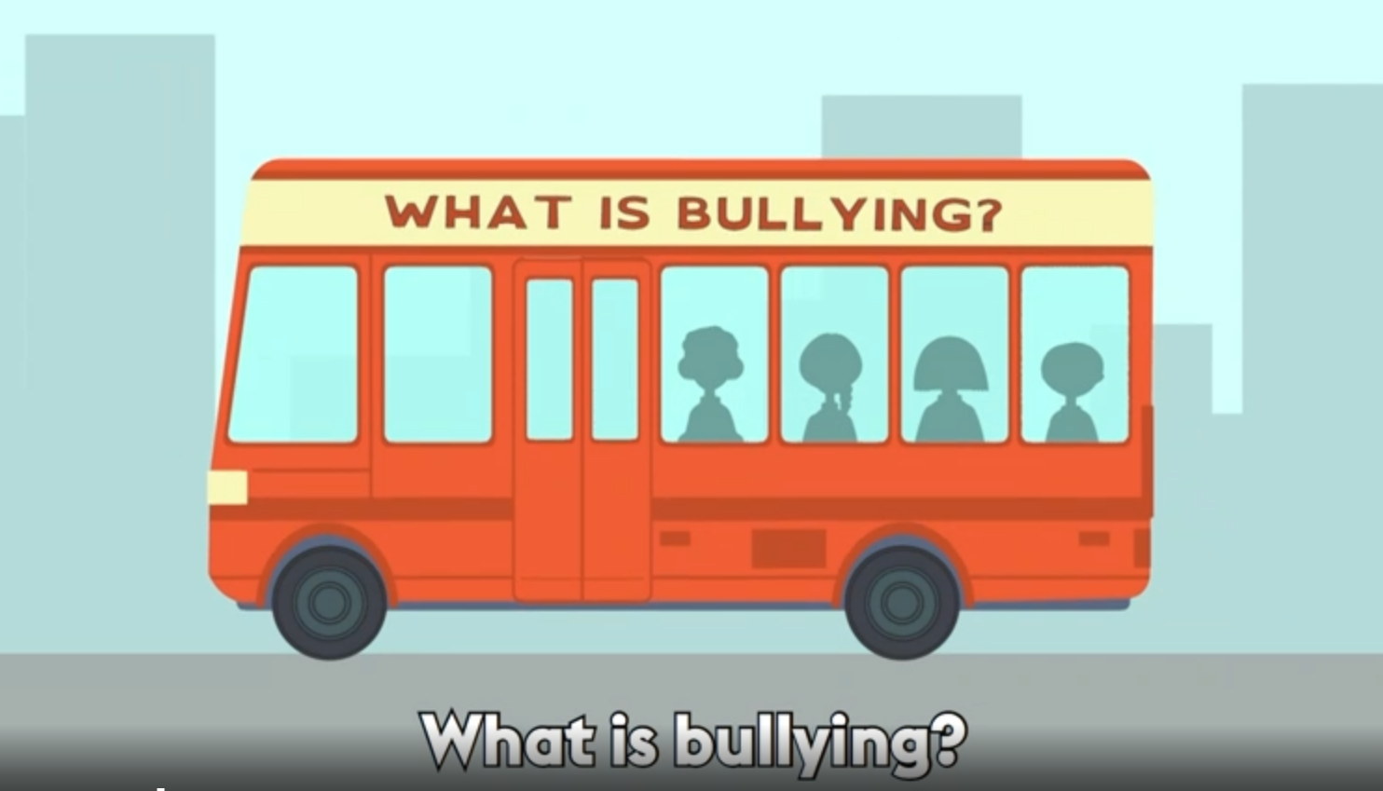
https://www.bbc.com/ownit/curations/anti-bullying-week-2023

