Slide 1

Always Look On The Bright Side of Life
https://www.youtube.com/watch?v=qgEa9a0Fxs8

Slide 2

Severnbanks Primary

Slide 3

https://www.youtube.com/watch?v=68vZX2uUKKA&t=1s

Slide 4

Do something funny for money

Slide 5
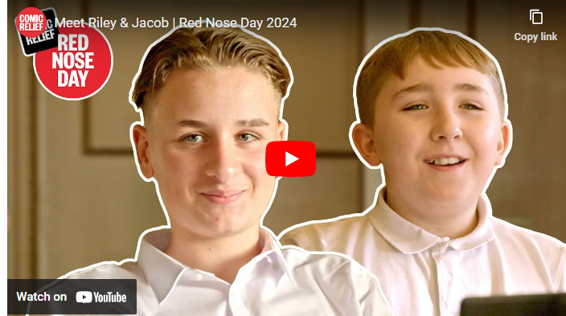
How does your money help?
https://youtu.be/53yP06drtfc

Slide 6
Why did the Maths book look sad?

Slide 7
Because it had too many problems!

Slide 8
Why was the broom always late for school?

Slide 9
It overswept!

Slide 10
What is a snake’s favourite subject?

Slide 11
Hisstory!

