Slide 1
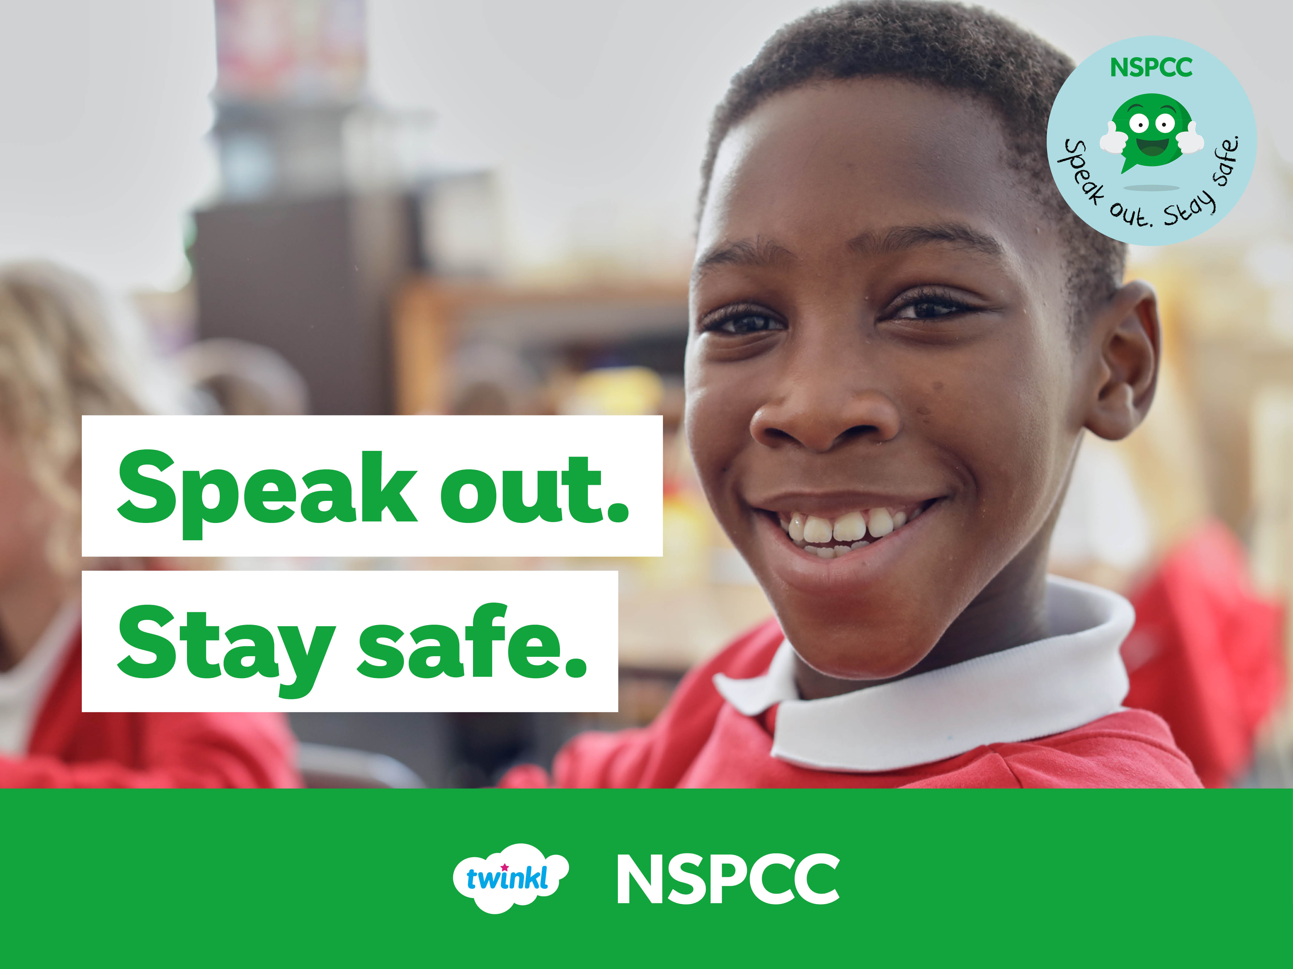

Slide 2
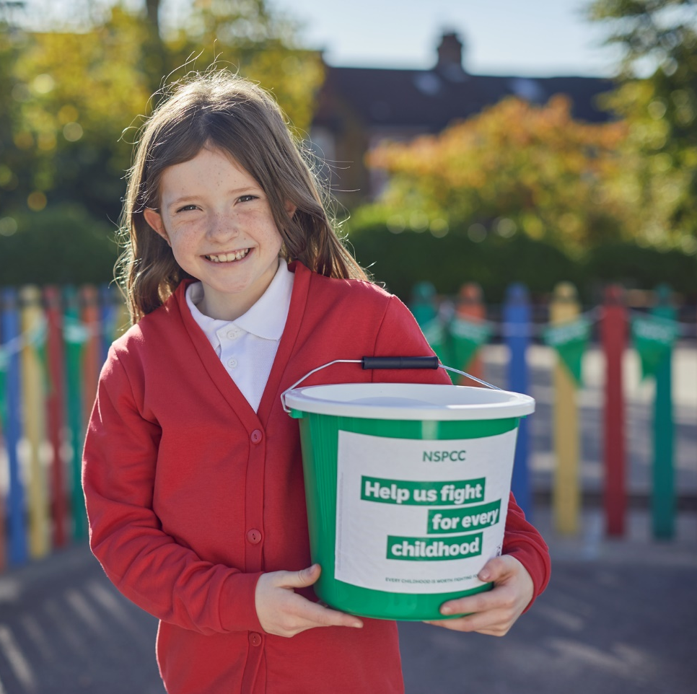
About the NSPCC
The NSPCC is the National Society for the Prevention of Cruelty to Children. It is the UK's leading children's charity and has been looking out for children for over 130 years.
The NSPCC supports children in lots of different ways: by visiting schools, supporting families, talking to politicians and campaigning for change to make children’s lives better.

Slide 3
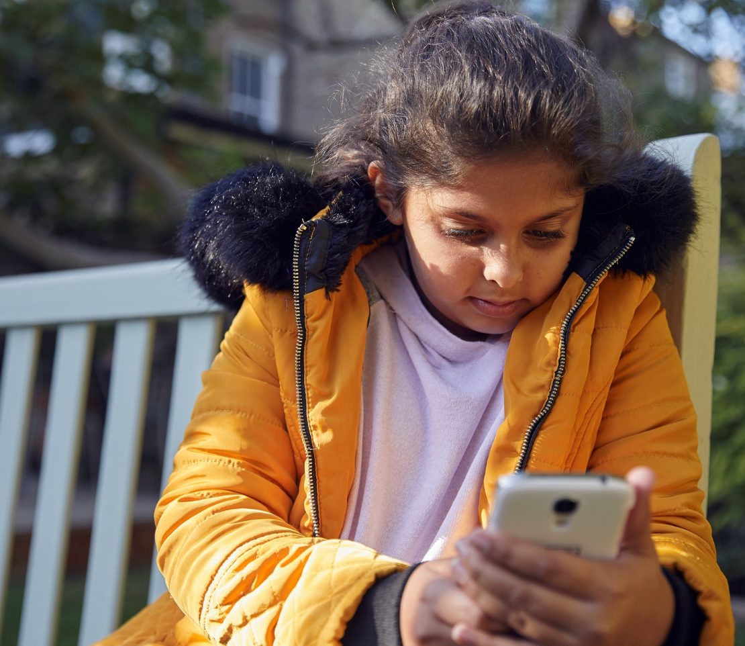

About Childline
Childline is a service just for children and young people where they can talk to someone if they're scared or worried about anything.
You can get in touch on the phone or online and can speak to Childline about anything you want to.
Click here to visit the Childline website.

Slide 4
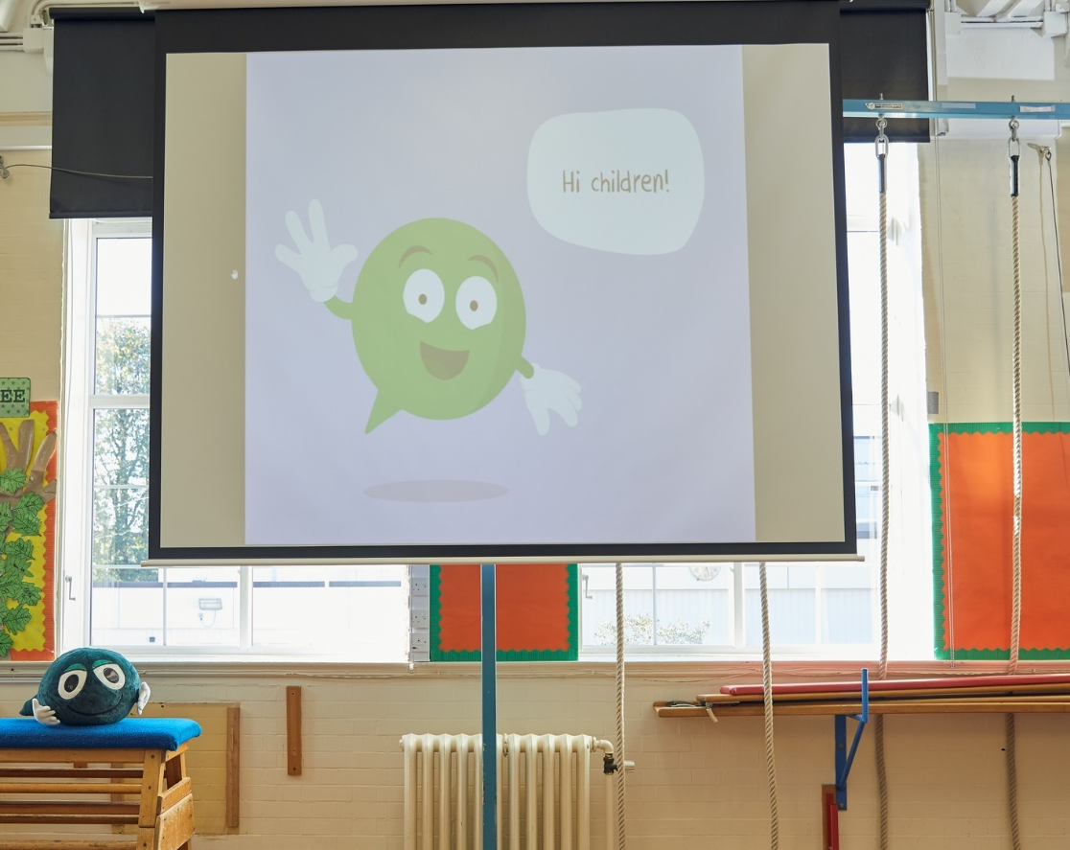
Speak out. Stay safe.
On Monday 29th January, EVERYONE across the school will be taking part in a Speak Out, Stay Safe assembly.
Year 6 children will have a workshop run by the NSPCC volunteers.
ALL Key Stage 2 children will be taking part in an online questionnaire.

Slide 5

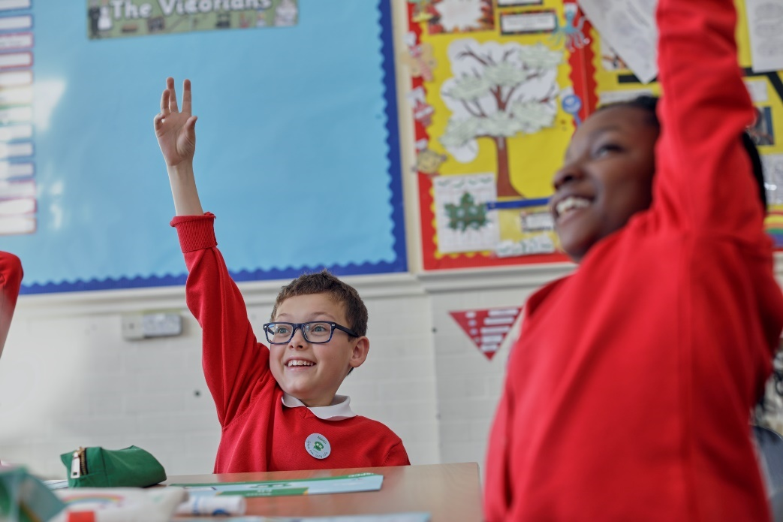



Your Rights
All humans have rights, and there are special rights for children. What do you know about your rights?
What are the most important rights you have in school?

Slide 6




Your Rights
You have the right
to an education.
You have the right to share your ideas and opinions.
You have the right
to a name and a nationality.
You have the
right to be safe.
You have the right to speak out and be heard if something is wrong.
You have the right to rest, play and take part in activities.
You have the right to healthcare when you are sick.
You have the right to have food, water and a place to live.
You have the right to get help when you need it.

Slide 7
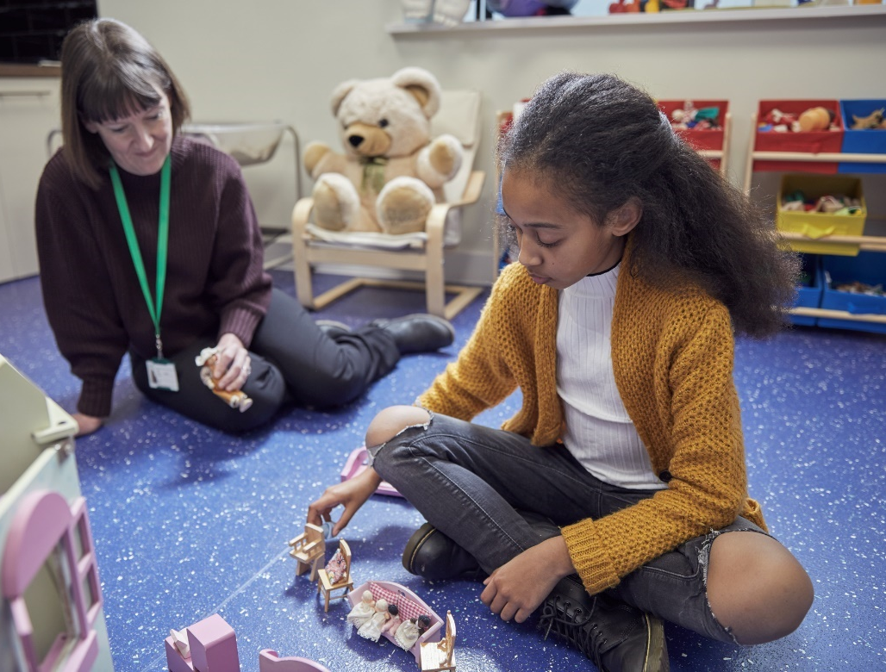
Your Rights
All children have the same rights. The adults who care for you have a responsibility to make sure that your rights are respected.
All children have the right to:
Speak out to a trusted adult
Be safe
Get help when they need it

