Slide 1

Celebrating our Differences!
What is Tourette Syndrome?

Slide 2
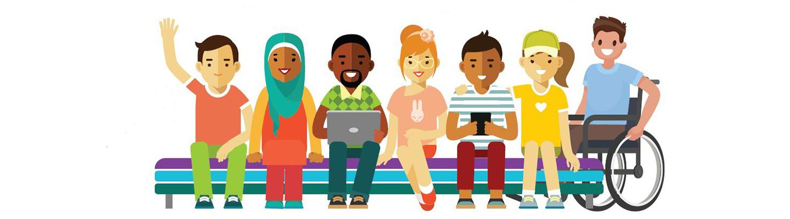
We are all different.
What differences do you see in this picture?

Slide 3
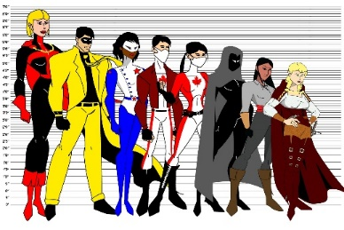
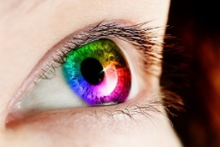
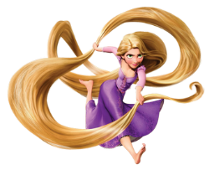
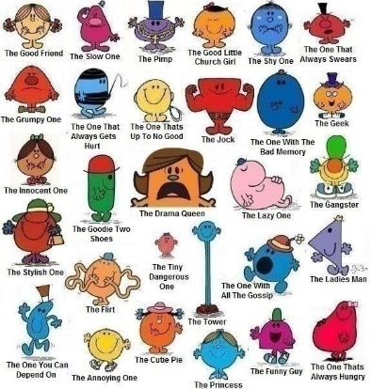
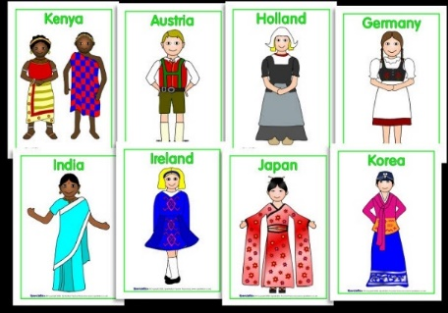

People can be different in so many ways
Colour of hair
Colour of skin
Colour of eyes
Our height
Our clothes
Our personalities

Slide 4

What differences do you see in your family?
What differences do we see in our school/classroom?

Slide 5

We are all different inside as well as outside but we cant always see it

Slide 6

Everybody’s brains are different and work in different ways

Slide 7

tourettes =
Tourette Syndrome (TS)

Slide 8
What is it?
Tourette Syndrome can be an inherited condition
People with Tourette Syndrome have tics
Tics mean you may make sounds and do movements you really can’t control
You can have tics at any age

Slide 9
What it’s not
Tourette Syndrome is not a mental illness
Tourette Syndrome does not affect how intelligent you are
You can’t catch it - it’s not infectious

Slide 10
What are tics?
Muscle movements or noises which the person can’t help doing
Tics can be fast
They can happen again and again
Tics can change
People with Tourette Syndrome are not doing them on purpose

Slide 11
Some examples of tics
jumping
Blinking
sniffing, sn, sn ,, ,, ,,,
hair flicking
,,,,,,,, clicking, ^{AHEM}clearing your throat^{AHEM} saying the same word over and over over and over over and over over and over over and over over and over over and over over and over over and over over and over over and over over and over over and over over and over over and over AND OVER AND OVER AND OVER AND OVER AND OVE
Shrugging
Coughing
nodding
touching
twirling

Slide 12
The swearing tic
This is just another type of tic (the one everyone knows about)
Although its uncommon in children with TS
In fact ...
... only approximately 10% of children with
TS has it
The name for this type of tic is “coprolalia”
(cop – row – LA – lee – ya)
We must remember that a swearing tic has no intentional meaning. Speak to an adult if you are worried by this.

Slide 13

Other Symptoms
People with TS often have other symptoms alongside their tics that we cant’s see. One of the most common of these is worrying thoughts or the feeling that something terrible might happen. These can be very hard to explain and may need your understanding.

Slide 14
Tics wax and wane
He didn’t do that last week ...
They come and go
They change in how severe they are
And how often they occur
He’s doing it all the time now.
She’s just putting it on.
People with Tourette Syndrome are not doing their tics on purpose.

Slide 15

Some people with TS may be able to stop their tics for a short time if they concentrate hard but this can feel very uncomfortable.
This sometimes confuses teachers and other pupils.
Lets try it!
Try not to blink for a whole minute and you’ll see how uncomfortable this feels. This feeling is how some children describe how it feels to have to hold a tic in.

Slide 16


Stop doing that! It’s driving me mad!
But I cant help it!
We must never ask a person with TS to stop ticcing.

Slide 17


Who has TS?
One in every hundred school children has TS
It occurs most commonly in boys
TS can often reduce and in some people even completely disappear by the age of 18
Did you know that the singer Billie Eilish and famous YouTuber Caspar Lee both have TS?

Slide 18


What can make my tics worse
Worry, stress, hunger, excitement, change, tiredness
What can make my tics better
Exercise, distraction, deep concentration, mindfulness, sleep, routine

Slide 19
How can you help someone with TS?
Learn as much about TS as you can
Talk to them and ask them how you can help
Be kind and understanding
Don’t tease them about their tics
Stand up for them if they are bullied. Tell an adult.
Give them some time on their own if they want to release some tics in private
Help them to join in - don’t leave them out

Slide 20
20
https://www.youtube.com/watch?v=LZQlch6v3W4
This link is to a video made by Tourettes Action in conjunction with the famous you tuber Caspar Lee to increase Tourettes Awareness. Casper has TS himself so is a great role model for our children and talks to a group of
School children about their TS, how it feels and how people can help.

Slide 21

You are now a Tourette Syndrome expert!
You now know more about Tourettes than most adults!
Why not test your mum and dad at home?

Slide 22
Thank you!

