Slide 1

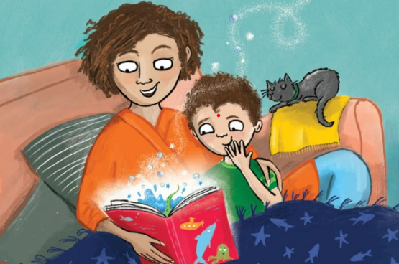
Reading at home

Slide 2
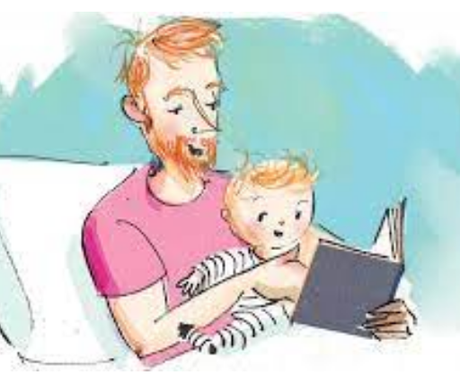
Reading at home
What is reading for pleasure?

Slide 3
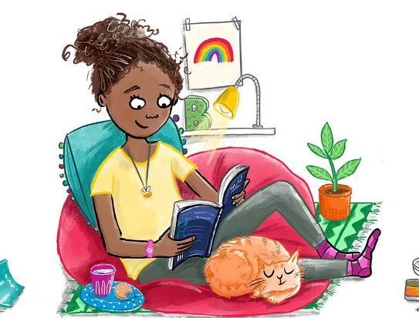
Everyone a reader
If I asked someone that you live with does…..read at home? What would they say?

Slide 4
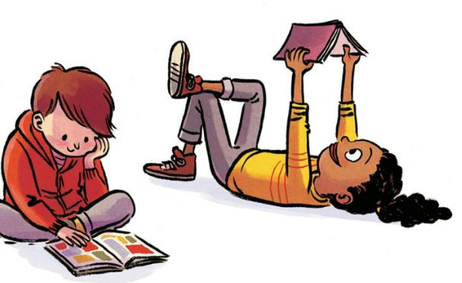
Everyone a reader
How often does your child pick up something to read without you telling them to?

Slide 5
Everyone a reader
What could your child read if they don’t want to pick up a book?

Slide 6
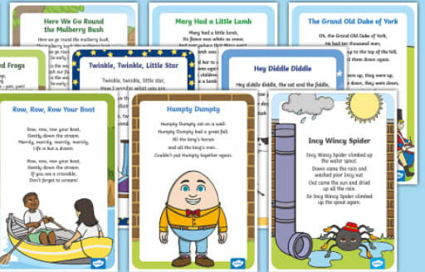







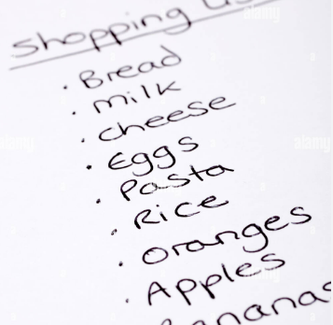

Everyone a reader

Slide 7


Everyone a reader
Why are bedtimes
stories so important for our children?
Children who are read to every night start school ahead of those who aren’t – and the gap only widens as they get older.
The Book Trust

Slide 8

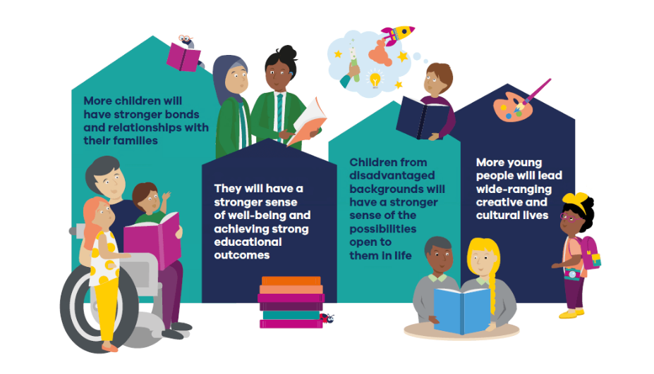
Everyone a reader
What are the benefits of reading?

Slide 9




Everyone a reader
Sharing books

Slide 10



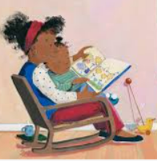
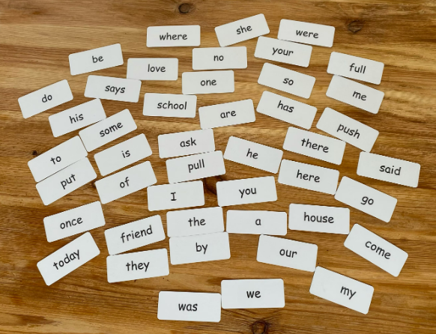
Everyone a reader
How do I read with my child at home?

Slide 11
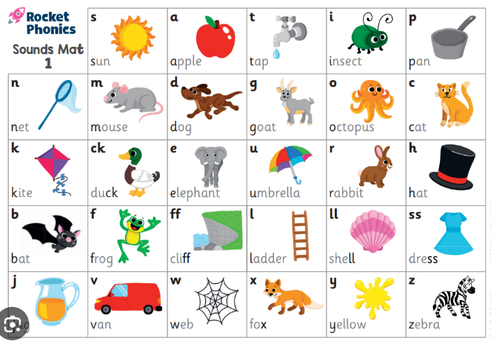
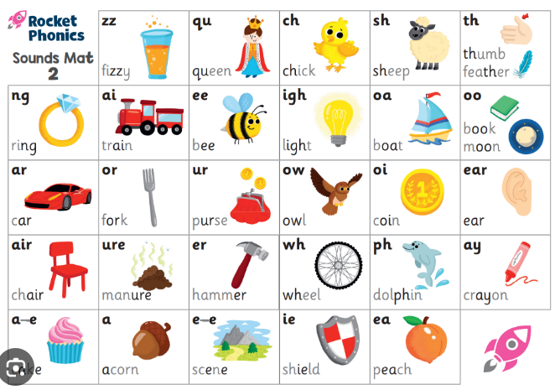
Everyone a reader
How do I help my child with their reading?
Phonics

Slide 12
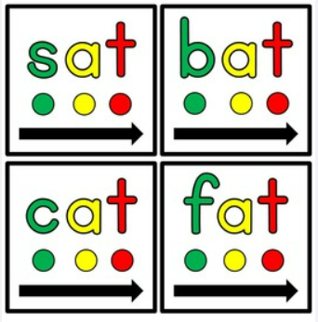

Everyone a reader
How do I help my child with their reading?
Segmenting and blending

Slide 13
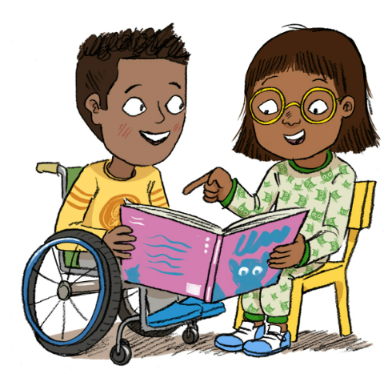

Everyone a reader
Talking about the book together
Ask lots of questions about what they
have read.
How do I help my child with their reading?
Who?
When?
What?
Why?
Where?

Slide 14
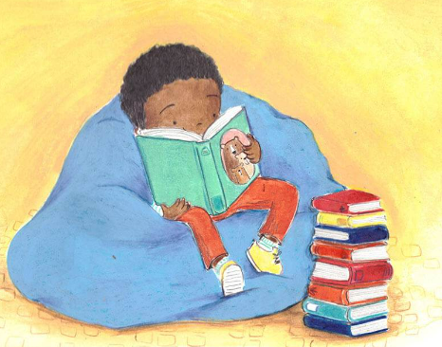

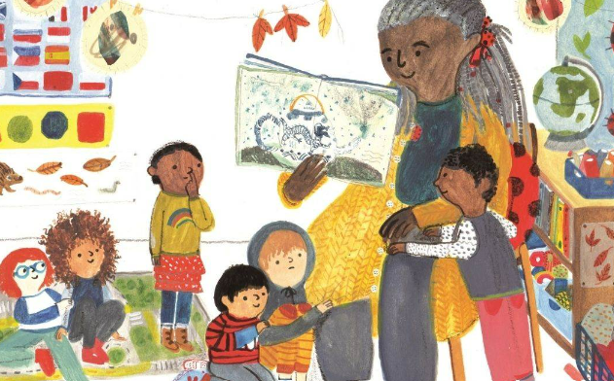
Everyone a reader
Reading is everyone's
responsibility
Working together

Slide 15
Everyone a reader
Please take some time to look at our phonics and reading
resources. We are very happy to answer any questions
you have.

