Slide 1


Slide 2





What are the age restrictions? Why?

Slide 3
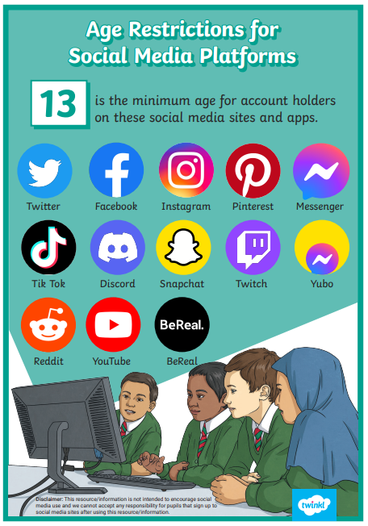
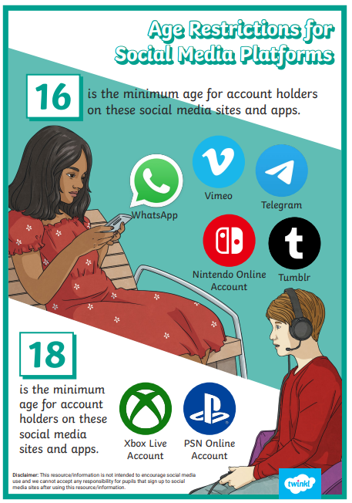

Slide 4





What do the following icon stand for?

Slide 5
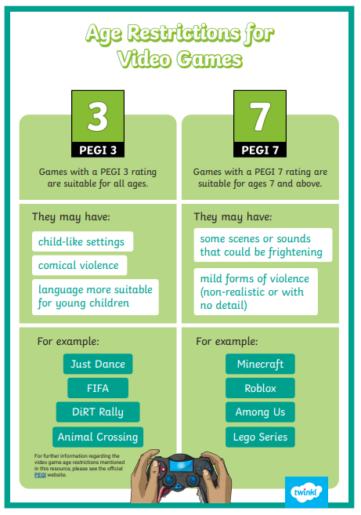
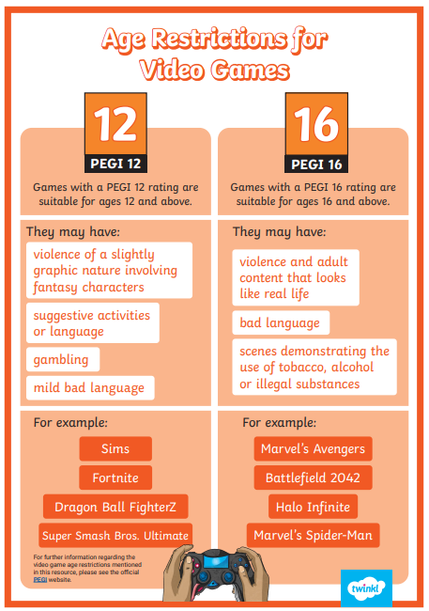

Slide 6
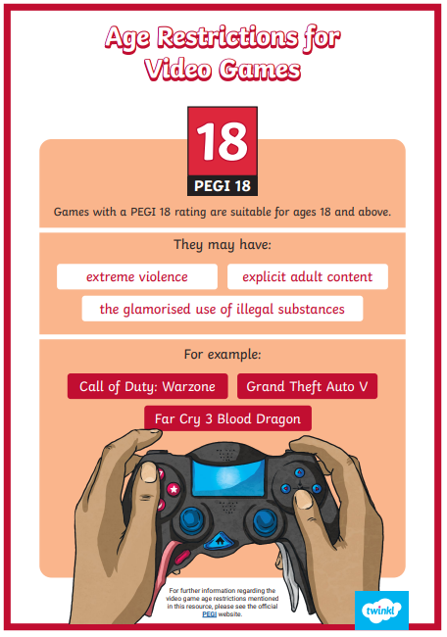

Slide 7


