Slide 1


Slide 2
Is this bullying?

Slide 3
Bullying is a type of unkind behaviour.
BUT
Not all unkindness is bullying

Slide 4
What is bullying?
Bullying is when someone, or a group of people, repeatedly and deliberately hurt someone else or a group of people.
It can come in many different forms.
Bullying can be physical (for example, pushing somebody around), emotional (for example, leaving somebody out) or verbal (such as saying nasty things to or about someone).
When bullying takes place online - for example, via social media or video games - it is called cyberbullying. This form of bullying has become more common, as more young people have mobile phones and computers than they used to.

Slide 5
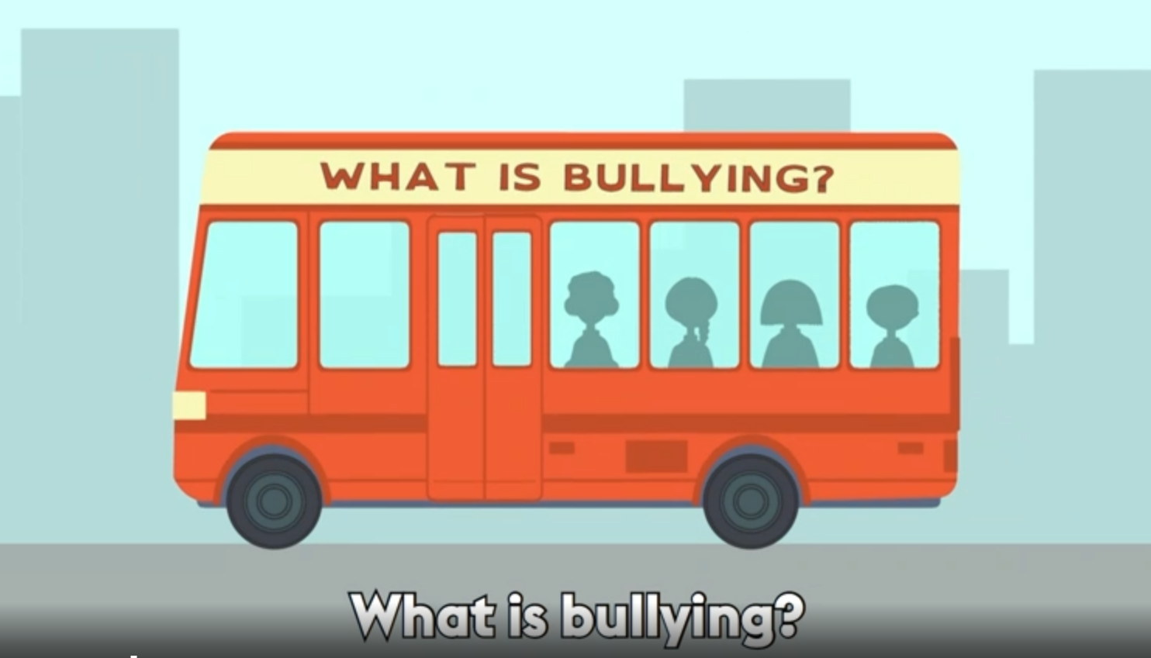
https://www.bbc.com/ownit/curations/anti-bullying-week-2023

Slide 6


