Slide 2

What Is Neurodiversity?
Definition:
  neuro – To be of nerves or nervous system
  diversity – A range of different things
Every brain is unique and every individual brain works in different ways.
Everyone has their own way of thinking and interacting with the world around them.

Slide 3

What Is Neurodiversity?
There are a number of neurological conditions that come under the umbrella term of ‘neurodiverse’ - you may have heard of the following conditions:
Autism
dyslexia
dyspraxia
ADHD

Slide 4
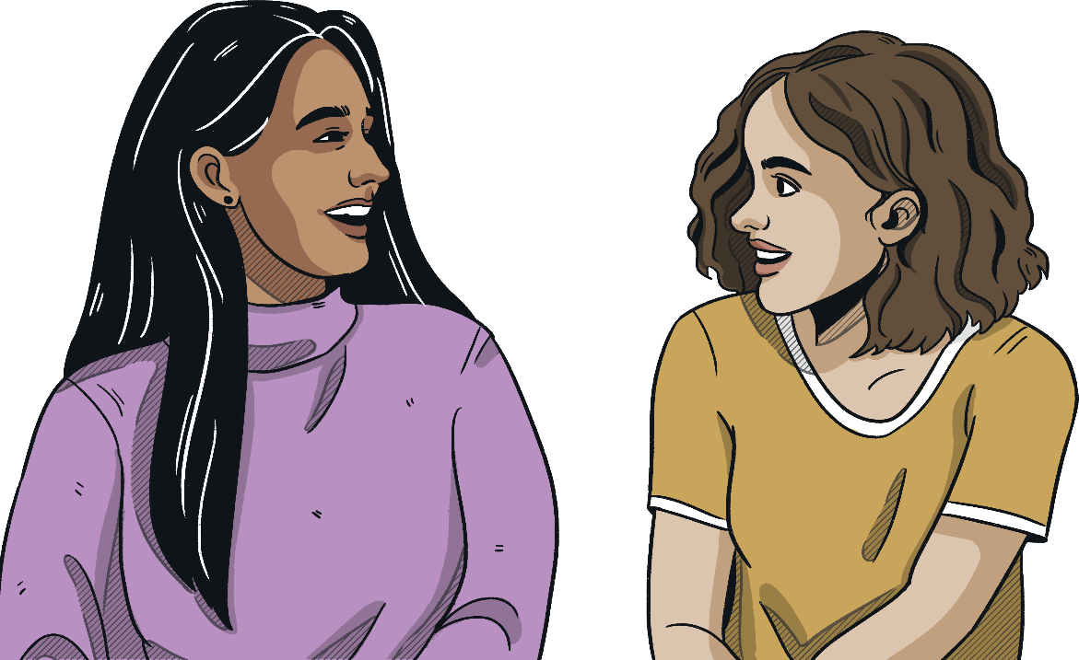
Autism – What Is It?
Autism is a spectrum condition which means that every Autistic person is different.
Some Autistic children and adults may also have additional learning needs, although this is not always the case. The amount of support an Autistic person needs is unique to each individual.

Slide 5

Dyslexia – What Is It?
Dyslexia is a specific learning difficulty where a person has difficulties with processing information.
Dyslexia can affect a person’s literacy skills in reading, writing and spelling. It may take them longer to learn to read, name letters, spell words and begin to write.
People with dyslexia experience difficulty with their memory skills – they may find it difficult to remember information, sequence ideas and retrieve information that they have learnt.
They can also find it hard to organise their work space and gather equipment for activities.
Some people with dyslexia may have difficulty
following instructions or listening in the
classroom. They may need extra time to
complete activities and they may need extra
thinking time.

Slide 6


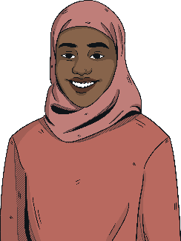
Dyspraxia – What Is It?
Dyspraxia is also known as Developmental Coordination Disorder (DCD).
People with dyspraxia may find it hard to remember things or understand what they are being asked to do.
They may have difficulties moving around and can often be mistaken for being clumsy.
People with dyspraxia may have trouble planning and organising themselves or have difficulty following a list of instructions.
They may also have difficulty with their speech; sometimes they can get the order of the sounds in words mixed up. They may also have difficulty with longer complex words and use shorter or more simple words to express themselves.
However, they may also be very creative and good at drama or musical activities.

Slide 7
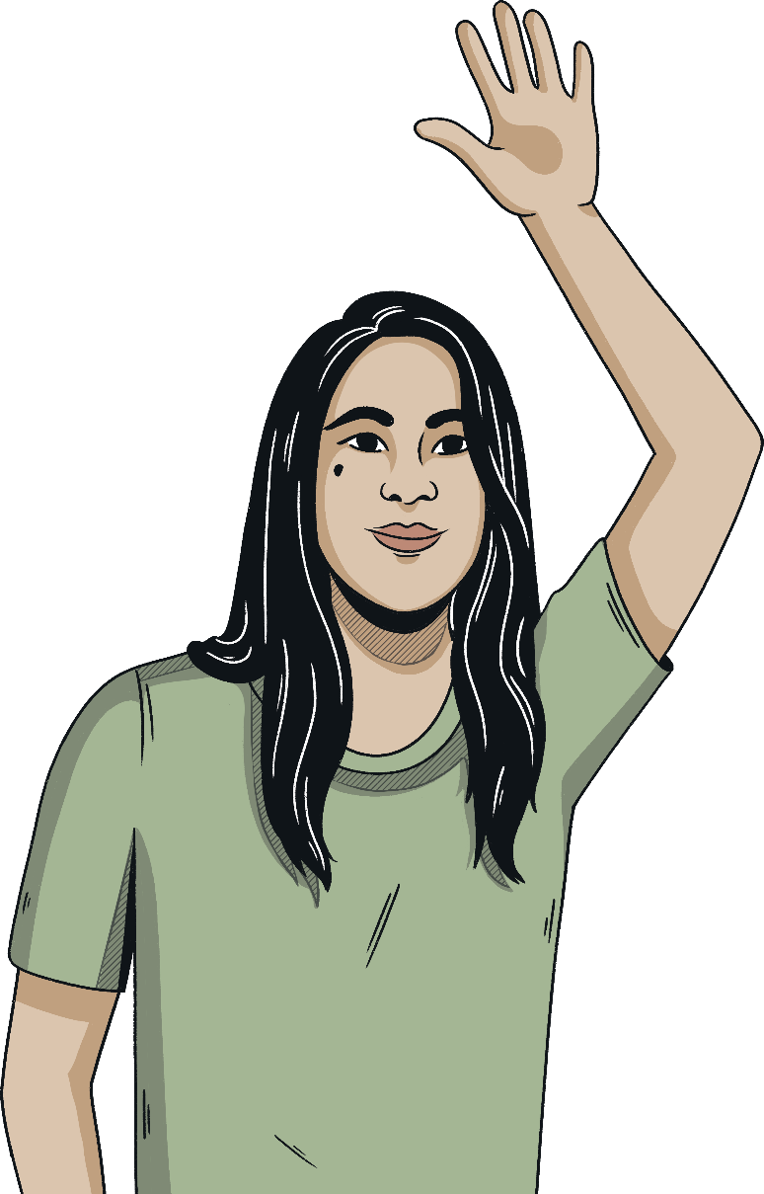
ADHD – What Is It?
People with ADHD may find it harder to control their activity level and their reactions to what is going on around them. Sometimes, they can be impulsive.
Some children with ADHD may have difficulty following instructions or listening in the classroom.
Some children with ADHD may move excessively or fidget. They may find it difficult to self-regulate.

Slide 8

https://www.youtube.com/watch?v=aai22wlrCtw

Slide 9

Important Things to Remember
Everyone is unique and this should be accepted.
We must appreciate each other's diversities.

