Slide 1
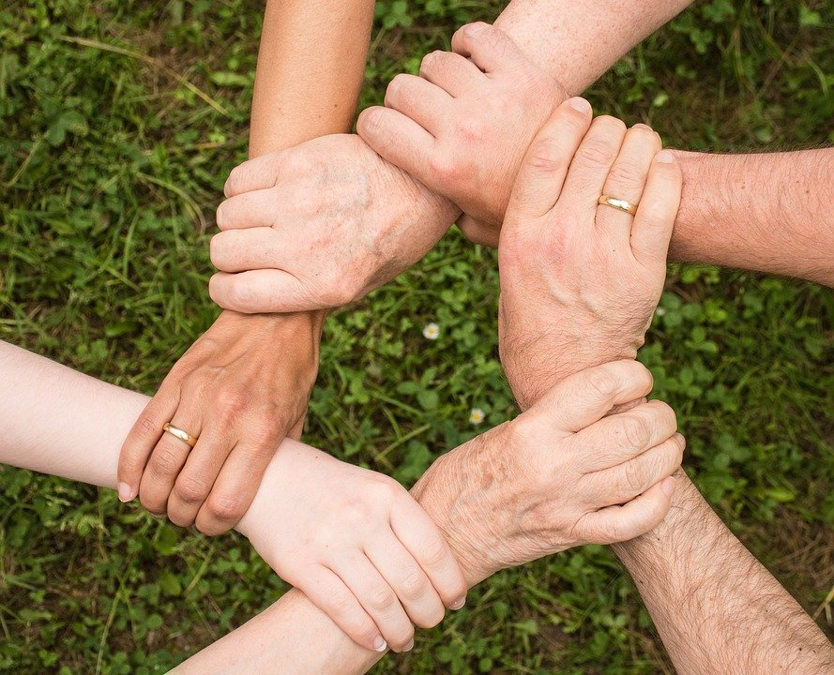
Teamwork
If you were to assign each letter a number
(A=1, B=2, C=3 etc.) what is the value of
the word teamwork?
106
Other words with the value of 106
Honesty
Persist

Slide 2

Its great when things just work…..
The cog

Slide 3

The numbers behind the advert
606 takes
20 sets of alloy wheels
10 bonnets
15 pots of paint
4 months to completion
1 million pounds
Notes:
Actual numbers behind the advert – This is about recognising that the advert did not work without hard work and dedication. It was not straight forward

Slide 4


What does this mean to me?
Preparation
Planning
Perseverance
Notes:
Preparation – Ask students to think about the sheer volume of preparation needed for one take, what if one small part did not work?
Planning – 4 months if continuous planning and tweaking – we are asking you to plan ahead
Perseverance – How frustrating when one take did not work! They kept on going…. You need to do the same

Slide 5
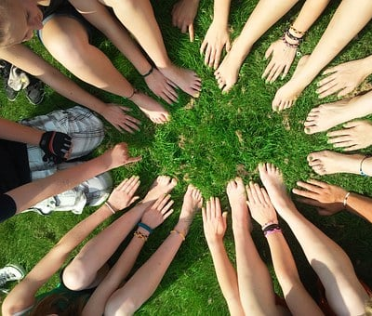
Why is teamwork important….
Teamwork is efficient work
Teams innovate faster
Teammates learn from each other
Healthy competition
Forms strong working relationships
Notes:
If the work load is shared whether this is on a football pitch or in a classroom everyone feels the benefit
Innovation – Im specific subjects you will be asked to work in group or pairs, this will help share ideas and ultimately benefit the ‘team’
Learn from each others strengths – again if you know someone who is good at something you find difficult ask them for help
Competition is important – This could be competition with yourself or others in the group
If you work well in teams you will foster good relationship with those around you and they will grow to value your opinions.

Slide 6

The whole is greater than
the sum of its parts
This is always true:
In sport
In music
In dance
In drama
And in the classroom
Notes:
This is the link back to school. Whether it is within your whole school or year group the importance of working together to become a successful unit.
You can elaborate on this point depends on time.

